Slide 1
Introduction to NTFS Permissions
Assign NTFS permissions to specify
  Which users and groups can gain access to folders and files
  What they can do with the contents of the folders and files
Available only on volumes formatted as NTFS
NTFS security is effective whether a user
  Gains access at the computer
  Gains access over the network

Slide 2
NTFS Folder Permissions
Read
Write
List Folder Contents
Read & Execute
Modify
Full Control

Slide 3
NTFS File Permissions
Read
Write
Read & Execute
Modify
Full Control

Slide 4
Who Can Apply NTFS Permissions?
Administrators
Owners of files and folders
Users with Full Control permission

Slide 5
Access Control List (ACL)
NTFS stores an ACL with every file and folder.
ACL contains
  A list of all user accounts and groups granted access.
  The type of access each user and group has been granted.
  An access control entry (ACE) for a user account or a group.

Slide 6
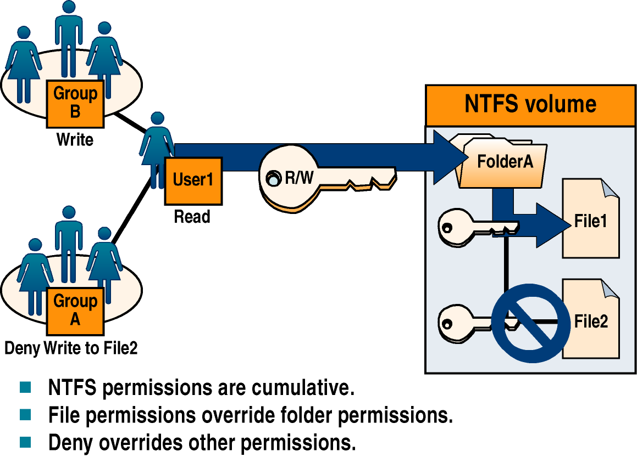
Multiple NTFS Permissions

Slide 7
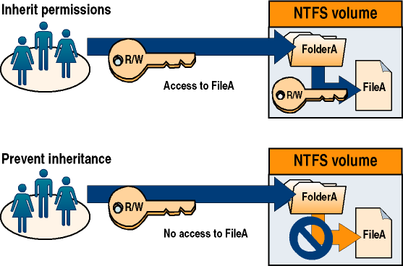
NTFS Permissions Inheritance

Slide 8
Planning NTFS Permissions Slide 1
Simplify administration.
  Organize files into groups.
  Keep home and public folders on a separate volume
  from the operating system and applications.
Allow only the level of access required.
Create groups according to the access requirements.

Slide 9
Planning NTFS Permissions Slide 2
For working with data or application folders
  Assign Read & Execute permission to the Users group.
  Assign Read & Execute permission to the Administrators group.
For working with public data folders
  Assign Read & Execute and Write permissions to the Users group.
  Assign the Full Control permission to the CREATOR OWNER user.

Slide 10
Planning NTFS Permissions Slide 3
Deny permissions only when it is essential.
Encourage users to assign permissions to their files and folders.

Slide 11
Setting NTFS Permissions
When you format a volume with NTFS, the Full Control
permission is assigned to the Everyone group.
Change this default permission and assign appropriate permissions.

Slide 12
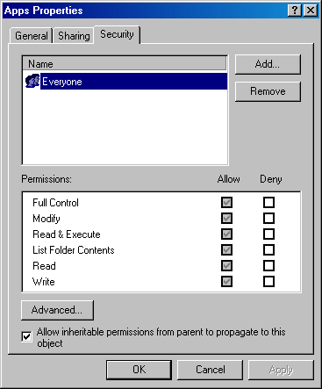
Assigning or Modifying NTFS Permissions

Slide 13
Preventing Permissions Inheritance
By default, subfolders and files inherit permissions.
Clear the Allow Inheritable Permissions From Parent
To Propagate To This Object check box, which will prompt you to select an option:
  Copy.
  Remove.
  Cancel.

Slide 14
Special Access Permissions
There are 14 special access permissions.
The Change Permissions special access permissions is one of the most frequently used. When you assign users the Change Permissions special access permission, you give them
  The ability to change permissions.
  You don’t have to assign them the Full Control permission.
  You don’t give them the ability to delete or write to the file or folder.

Slide 15
Taking Ownership
Current owner or a user with Full Control permission
  Assigns a user the Full Control permission.
  Assigns a user Take Ownership permission.
User can now take ownership of a file or folder.
An administrator can take ownership of a file or folder.
You cannot assign anyone ownership of a file or folder.

Slide 16
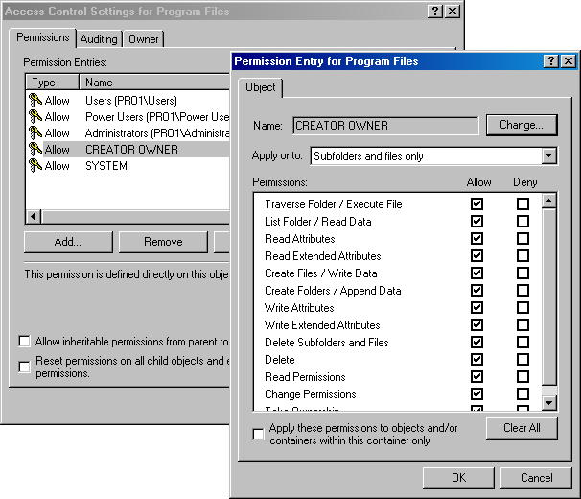
Setting Special Access Permissions

Slide 17
Taking Ownership of a File or Folder
Select your name in the Change Owner To list.
Select the Replace Owner On Subcontainers And Objects check box.

Slide 18
Copying Files and Folders
Causes permissions to change
Assigns the new file or folder the destination folder’s permissions
Requires you to have Write permission for the destination folder
Makes you the CREATOR OWNER of the new file or folder
Loses all NTFS permissions when you copy them to a FAT volume

Slide 19
Moving Files or Folders Within a Single NTFS Volume
Retains the original permissions
Requires you to have Write permission for the destination folder
Requires you to have Modify permission for the source file or folder
Retains the original owner of the file or folder

Slide 20
Moving Files or Folders Between NTFS Volumes
Causes the file or folder to inherit the permissions of the destination folder
Requires you to have Write permission for the destination folder
Requires you to have Modify permission for the source file or folder
Causes you to become the CREATOR OWNER of the file or folder
Loses all NTFS permissions when you move them to a FAT volume

Slide 21
Solving Permissions Problems
A user can’t gain access to a file or folder.
You add a user account to a group to give the user access
to a file or folder, but the user still can’t gain access.
A user with Full Control permission to a folder deletes a file in the folder, but that user doesn’t have permission to delete the file itself.

